Slide 1
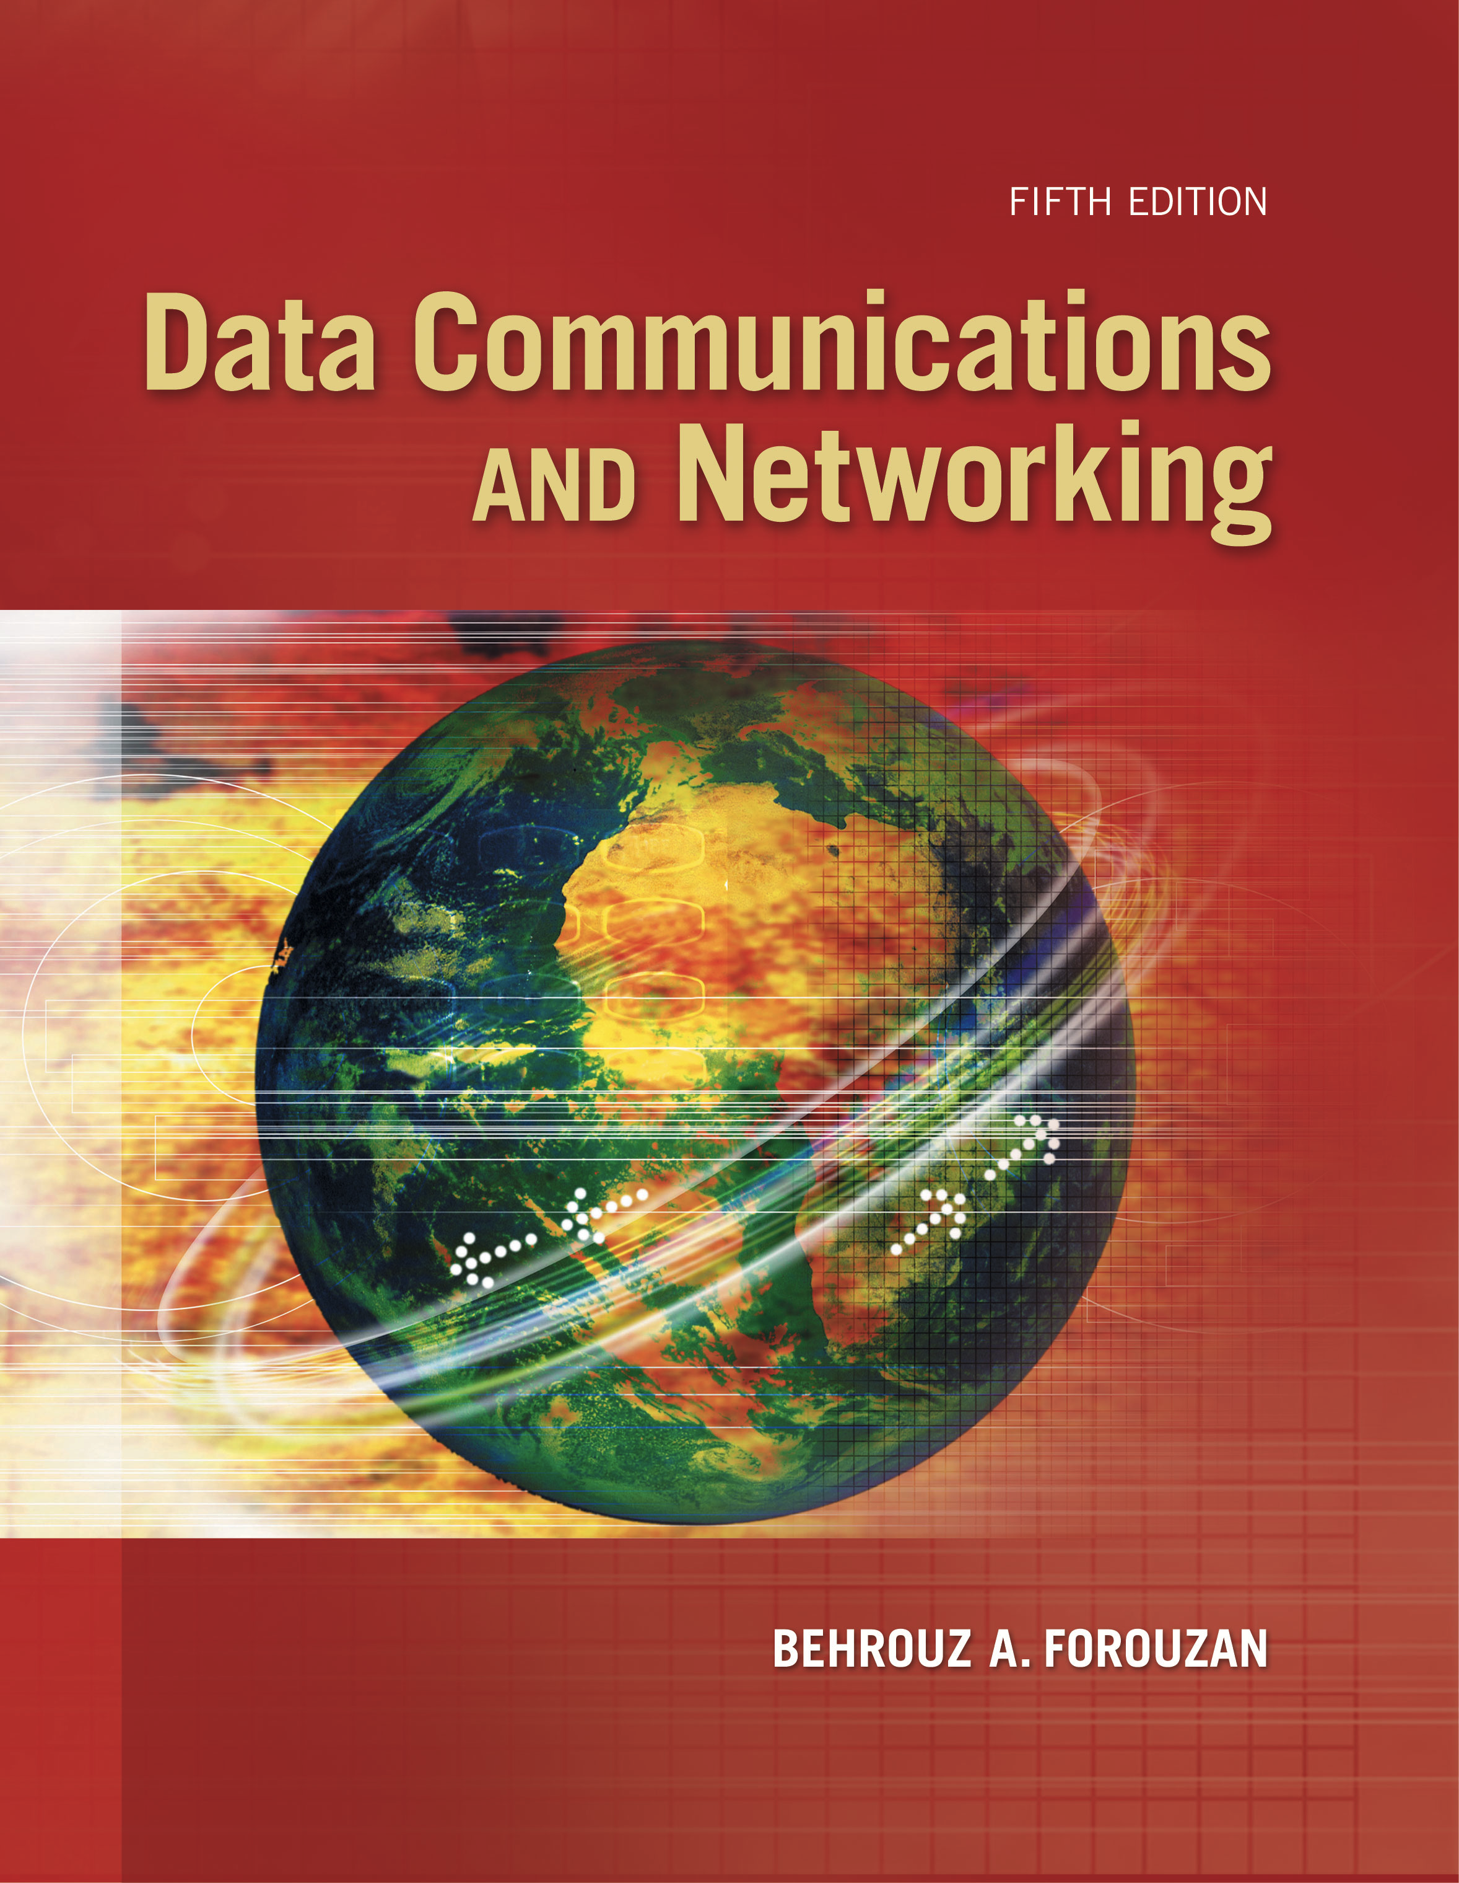
Computer Networks
DHCP, NAT, Forwarding IP Packets
S.V.Jansi Rani
Associate Professor / CSE

Slide 2
AGENDA
IPV4 Addresses
DHCP
NAT
Forwarding of IP Packets
MPLS

Slide 3



Slide 4
Dynamic Host Configuration Protocol
Large organization or an ISP can receive a block of addresses directly from ICANN
Small organization can receive a block of addresses from an ISP - Network administration- manually assign addresses to the individual hosts or routers.
Address assignment - automatically – DHCP
DHCP is an application-layer program, using the client-server paradigm, that actually helps TCP/IP at the network layer.
DHCP can be used in many situations. A network manager can configure DHCP to assign permanent IP addresses to the host and routers.
DHCP – temporary , on demand, IP addresses to hosts –
Eg: 100 used by 500 customers

Slide 5
DHCP
DHCP can be used to provide
IP address
Prefix
Address of a router
IP address of a name server

Slide 6
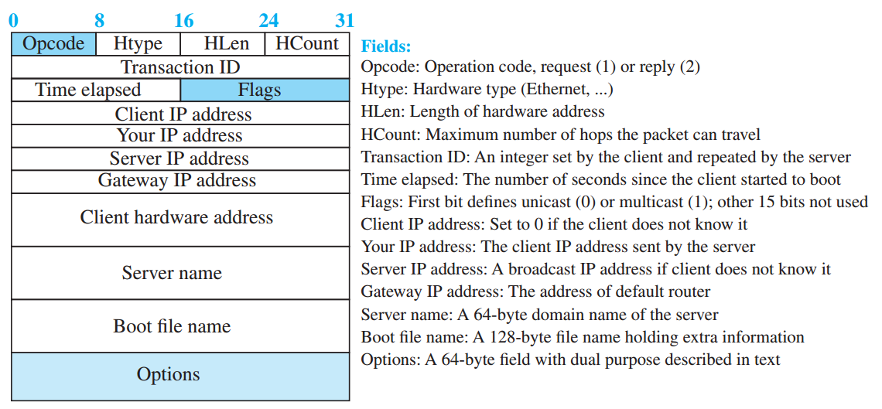
DHCP

Slide 7
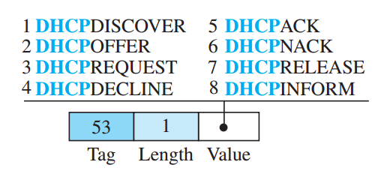
DHCP
DHCP message format
The 64-byte option field has a dual purpose. It can carry either additional information or some specific vendor information.
The server uses a number, called a magic cookie, in the format of an IP address with the value of 99.130.83.99
When the client finishes reading the message, it looks for this magic cookie. If present, the next 60 bytes are options. An option is composed of three fields: a 1-byte tag field, a 1-byte length field, and a variable-length value field. There are several tag fields that are mostly used by vendors.

Slide 8
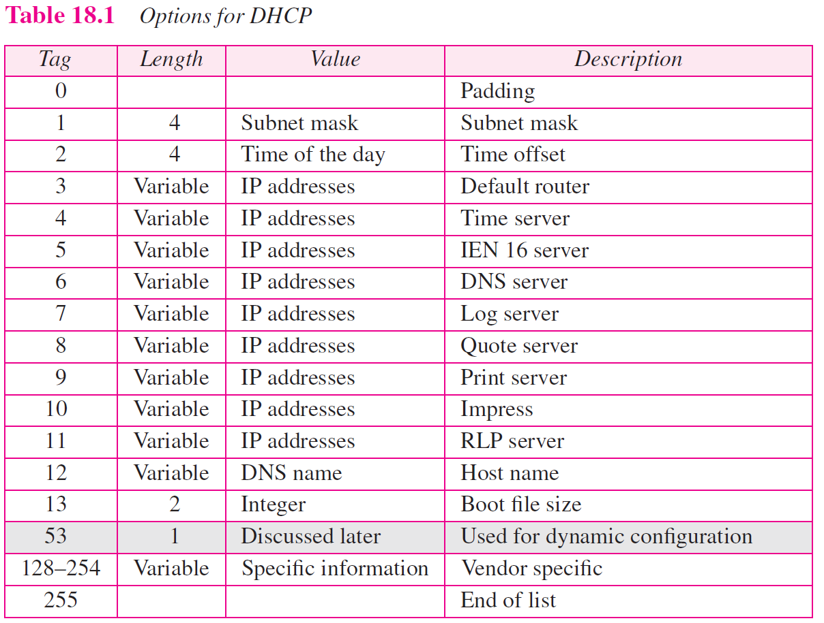

Slide 9
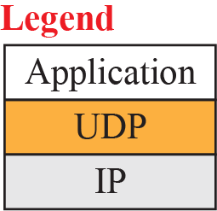
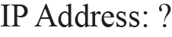
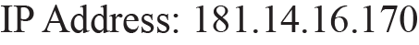
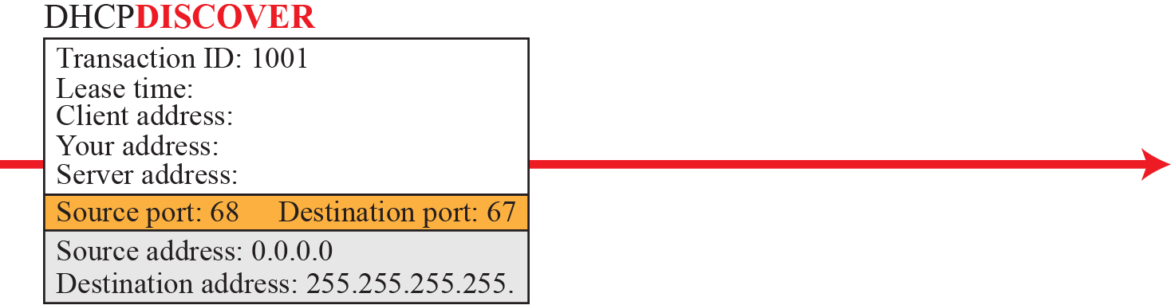
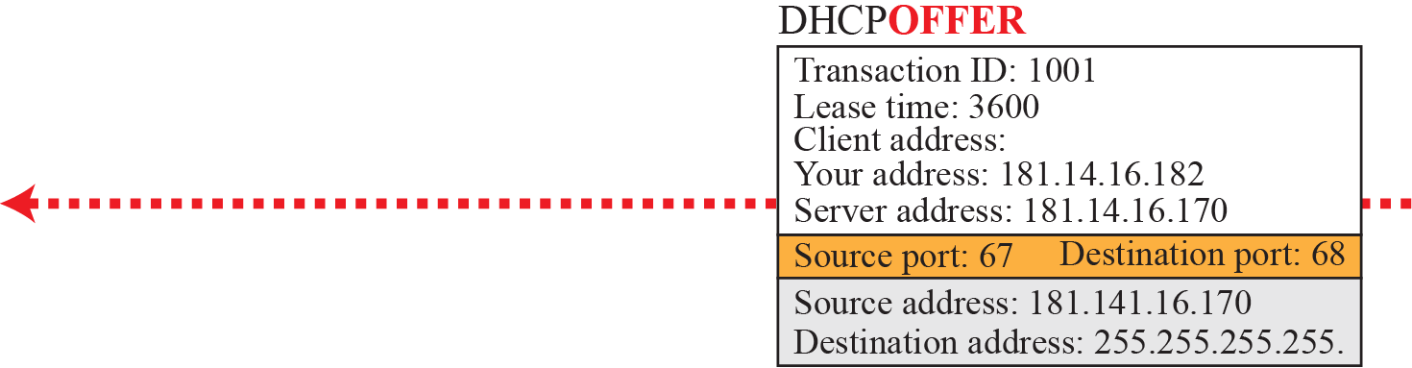
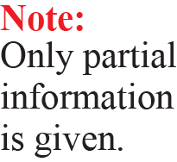
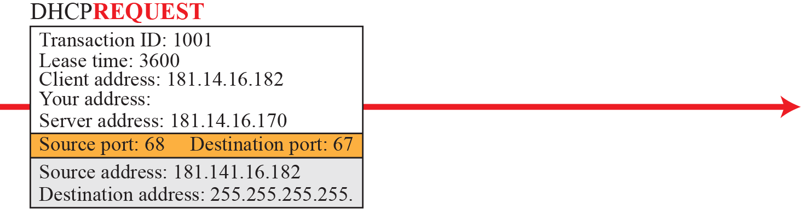
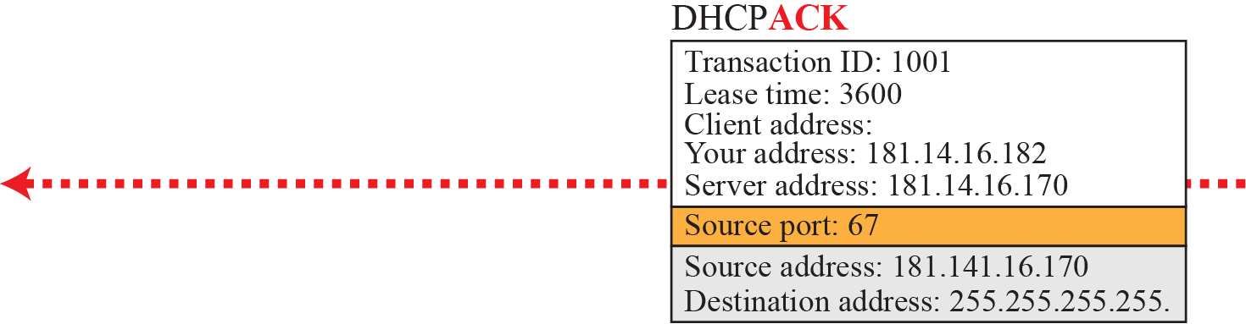
Simple scenario
Port No:
Client – 68,
Server -67

Slide 10
DHCP
Two well-known ports
You may ask what happens if two DHCP clients are running at the same time. This can happen after a power failure and power restoration.
In this case the messages can be distinguished by the value of the transaction ID, which separates each response from the other.

Slide 11
DHCP
Using FTP
The server does not send all of the information that a client may need for joining the network.
In the DHCPACK message, the server defines the pathname of a file in which the client can find complete information such as the address of the DNS server.
Client – FTP - to obtain the rest of the needed information.

Slide 12
DHCP
Error control
DHCP uses the service of UDP, which is not reliable. To provide error control, DHCP uses two strategies.
First, DHCP requires that UDP use the checksum.
Second, the DHCP client uses timers and a retransmission policy if it does not receive the DHCP reply to a request. However, to prevent a traffic jam when several hosts need to retransmit a request (for example, after a power failure), DHCP forces the client to use a random number to set its timers.

Slide 13
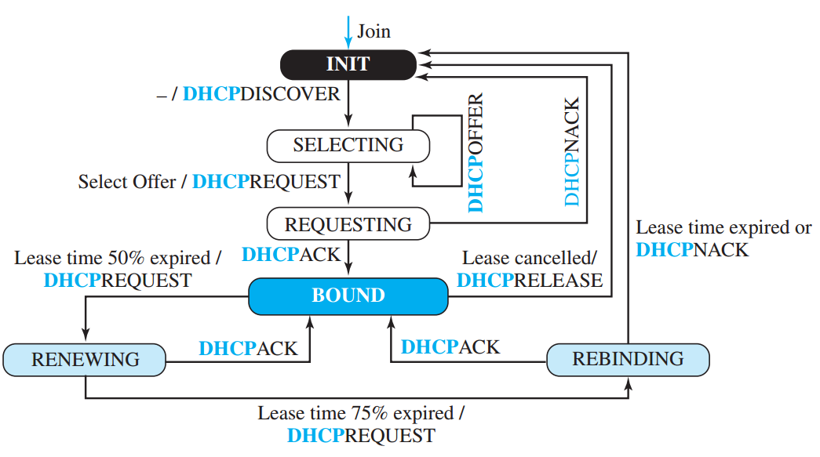
DHCP –State Machine

Slide 14
DHCP
Transition states
When the DHCP client first starts, it is in the INIT state (initializing state). The client broadcasts a discover message.
When it receives an offer, the client goes to the SELECTING state. While it is there, it may receive more offers.
After it selects an offer, it sends a request message and goes to the REQUESTING state.
If an ACK arrives while the client is in this state, it goes to the BOUND state and uses the IP address.

Slide 15
DHCP
Transition states
When the lease is 50 percent expired, the client tries to renew it by moving to the RENEWING state. If the server renews the lease, the client moves to the BOUND state again.
If the lease is not renewed and the lease time is 75 percent expired, the client moves to the REBINDING state. If the server agrees with the lease (ACK message arrives), the client moves to the BOUND state and continues using the IP address; otherwise, the client moves to the INIT state and requests another IP address.
Note that the client can use the IP address only when it is in the BOUND, RENEWING, or REBINDING state.
The above procedure requires that the client uses three timers: renewal timer (set to 50 percent of the lease time), rebinding timer (set to 75 percent of the lease time), and expiration timer (set to the lease time).

Slide 16
Network address translation(nat)

Slide 17
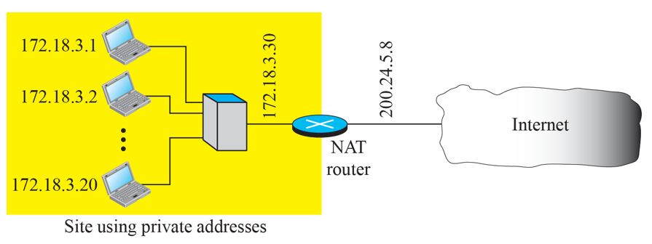
NAT
A technology that can provide the mapping between the private and universal addresses, and at the same time support virtual private networks, is Network Address Translation (NAT).
Private addresses - internal communication
Global Internet addresses (at least one) – outside world

Slide 18
NAT
As the figure shows, the private network uses private addresses. The router that connects the network to the global address uses one private address and one global address. The private network is invisible to the rest of the Internet; the rest of the Internet sees only the NAT router with the address 200.24.5.8.

Slide 19
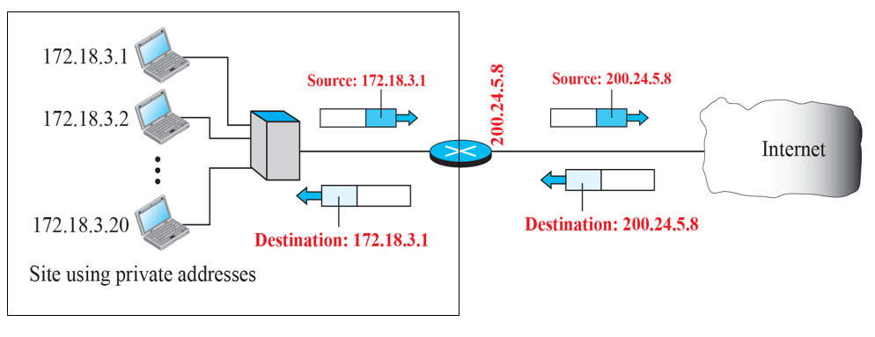
NAT
Address translation
NAT router -address translation.

Slide 20
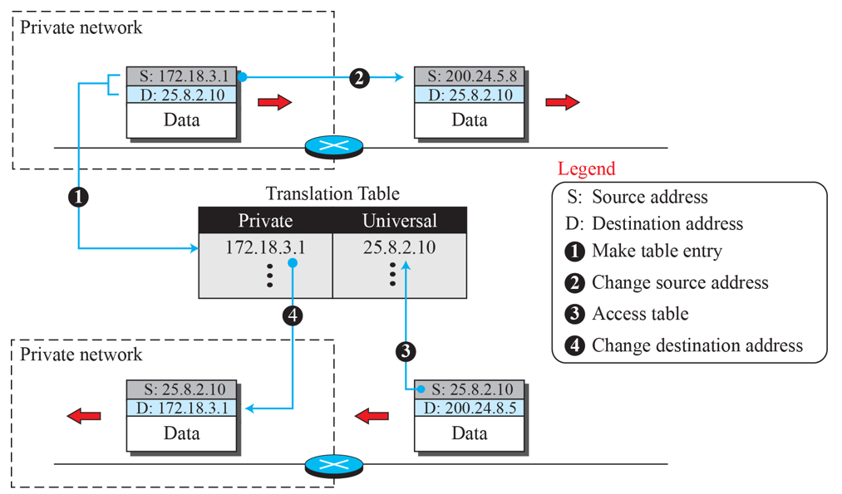
NAT

Slide 21
NAT
Using a pool of IP addresses
The use of only one global address by the NAT router allows only one private-network host to access a given external host. To remove this restriction, the NAT router can use a pool of global addresses.
For example, instead of using only one global address (200.24.5.8), the NAT router can use four addresses (200.24.5.8, 200.24.5.9, 200.24.5.10, and 200.24.5.11). In this case, four private-network hosts can communicate with the same external host at the same time because each pair of addresses defines a separate connection.
However, there are still some drawbacks. For example, two private-network hosts cannot access the same external server program (e.g., HTTP or TELNET) at the same time. –Use both IP addresses and port addresses.

Slide 22
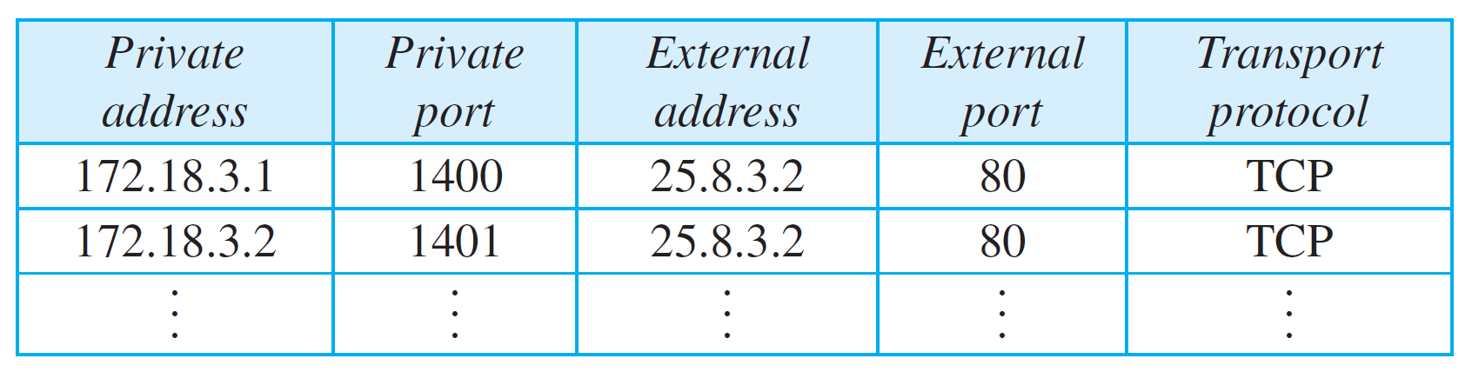
NAT
Using both IP addresses and port addresses
172.18.3.1 and 172.18.3.2 need to access the HTTP server on external host 25.8.3.2.

Slide 23
NAT
Using both IP addresses and port addresses
Note that when the response from HTTP comes back, the combination of source address (25.8.3.2) and destination port address (1401) defines the private network host to which the response should be directed. Note also that for this translation to work, the ephemeral port addresses (1400 and 1401) must be unique.

Slide 24
18-5 FORWARDING OF IP PACKETS
Internet today is made of a combination of links (networks), forwarding means to deliver the packet to the next hop (which can be the final destination or the intermediate connecting device).
When IP is used as a connectionless protocol, forwarding is based on the destination address of the IP datagram; when the IP is used as a connection-oriented protocol, forwarding is based on the label attached to an IP datagram.

Slide 25
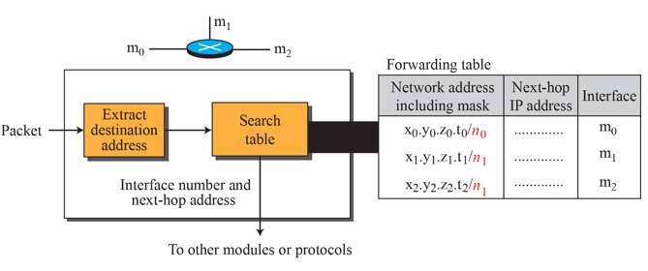
Destination Address Forwarding
A classless forwarding table needs to include four pieces of information: the mask, the network address, the interface number, and the IP address of the next router.
Combine the two as one piece of information: 180.70.65.192/26.

Slide 26
Destination Address Forwarding
The job of the forwarding module is to search the table, row by row.
In each row, the n leftmost bits of the destination address (prefix) are kept and the rest of the bits (suffix) are set to 0s.
If the resulting address (which we call the network address), matches with the address in the first column, the information in the next two columns is extracted; otherwise the search continues.
Normally, the last row has a default value in the first column (not shown in the figure), which indicates all destination addresses that did not match the previous rows.

Slide 27
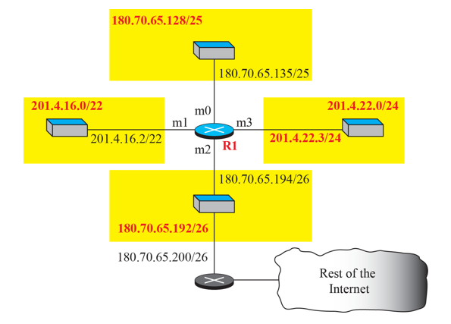
Destination Address Forwarding

Slide 28
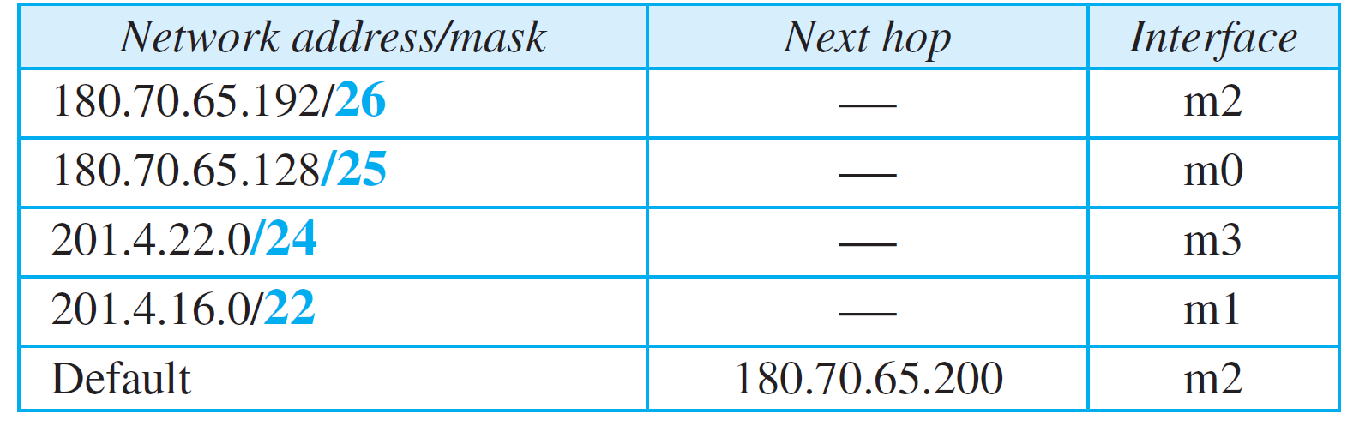
Destination Address Forwarding

Slide 29
Destination Address Forwarding
Example Show the forwarding process if a packet arrives at R1 with the destination address 180.70.65.140.
Solution
The router performs the following steps:
1. The first mask (/26) is applied to the destination address. The result is 180.70.65.128, which does not match the corresponding network address.
2. The second mask (/25) is applied to the destination address. The result is 180.70.65.128, which matches the corresponding network address. The next-hop address and the interface number m0 are extracted for forwarding the packet.

Slide 30
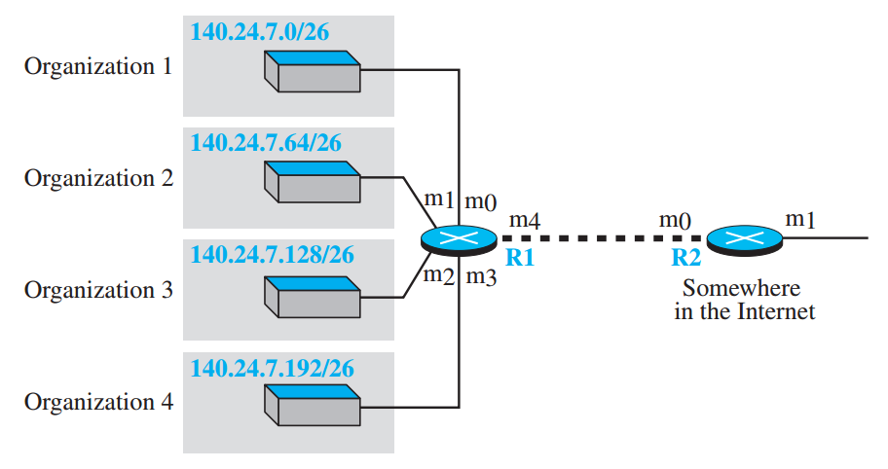
Destination Address Forwarding
Address aggregation
Using address aggregation, the number of forwarding table entries can be reduced.
For example, R1 is connected to networks of four organizations that each use 64 addresses. R2 is somewhere far from R1.

Slide 31
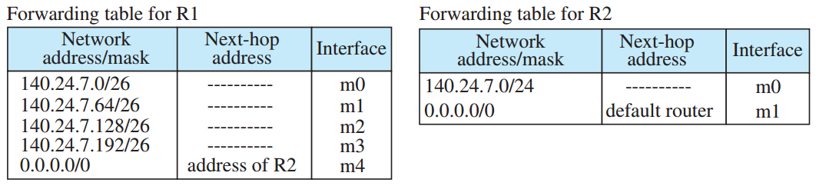
Destination Address Forwarding
Address aggregation
R1 has a longer forwarding table because each packet must be correctly routed to the appropriate organization. R2, on the other hand, can have a very small forwarding table. For R2, any packet with destination 140.24.7.0 to 140.24.7.255 is sent out from interface m0 regardless of the organization number. This is called address aggregation because the blocks of addresses for four organizations are aggregated into one larger block. R2 would have a longer forwarding table if each organization had addresses that could not be aggregated into one block.

Slide 32
Destination Address Forwarding
Longest mask matching
For example, if organization 4 cannot be connected to router R1 for some reason, can we still use the idea of address aggregation and still assign block 140.24.7.192/26 to organization 4?
The answer is yes, because routing in classless addressing uses another principle, longest mask matching. This principle states that the forwarding table is sorted from the longest mask to the shortest mask.

Slide 33
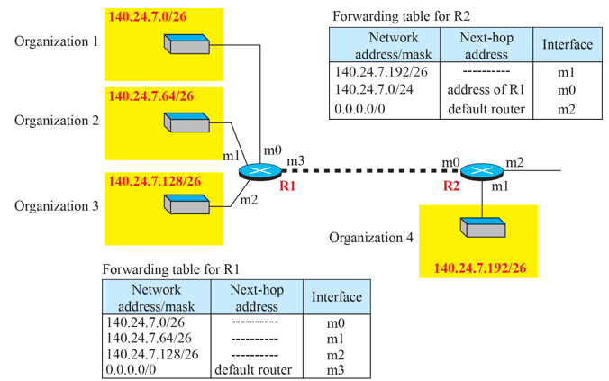
Destination Address Forwarding
Longest mask matching
The packet is routed correctly from interface m1 and reaches organization 4.
If, however, the forwarding table was not stored with the longest prefix first, applying the /24 mask would result in the incorrect routing of the packet to router R1. Eg: 140.24.7.200

Slide 34
Destination Address Forwarding
Hierarchical routing
To solve the problem of gigantic forwarding tables, we can create a sense of hierarchy in the forwarding tables.

Slide 35
Destination Address Forwarding
Hierarchical routing
How does this reduce the size of the forwarding table? The rest of the Internet does not have to be aware of this division. All customers of the local ISP are defined as a.b.c.d/n to the rest of the Internet.
Every packet destined for one of the addresses in this large block is routed to the local ISP.
Only one entry in every router in the world for all of these customers.
I
nside the local ISP, the router must recognize the subblocks and route the packet to the destined customer.

Slide 36
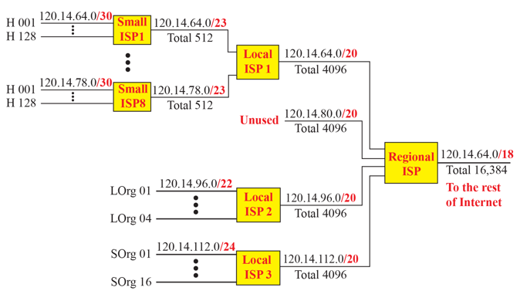
Destination Address Forwarding
Hierarchical routing

Slide 37
Forwarding based on Label
In the 1980s, an effort started to somehow change IP to behave like a connection oriented protocol in which the routing is replaced by switching.
Connectionless network (datagram approach), a router forwards - destination address
Connection-oriented network (virtual-circuit approach), a switch - label attached to the packet.
Routing - searching the table
Switching - accessing a table using an index

Slide 38
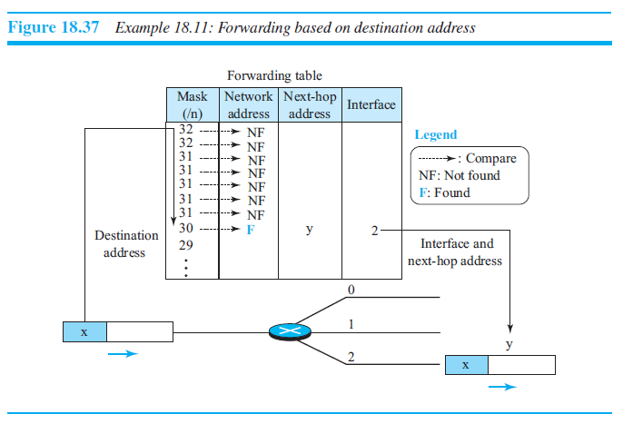

Slide 39
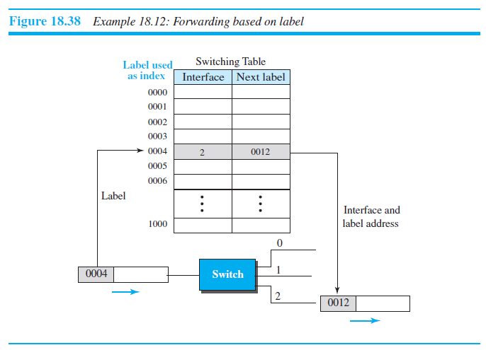

Slide 40
Destination Address Forwarding
Multi Protocol Label Switching(MPLS)
During the 1980s, several vendors created routers that implement switching technology.
IETF approved a standard - conventional routers in the Internet can be replaced by MPLS routers - behave like a router and a switch.
When behaving like a router - forward the packet based on the destination address
When behaving like a switch - forward a packet based on the label.

Slide 41
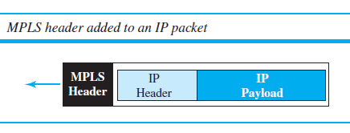
MPLS Header

Slide 42
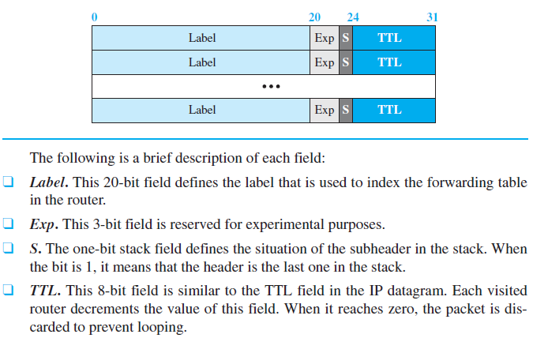
MPLS Header

Slide 43
Check Your Understanding
What is the use for DHCP?
Why label is used instead of address?

Slide 44
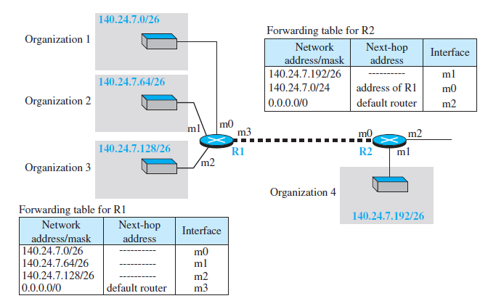
Check Your Understanding
Can R1 receive a packet with destination 140.24.7.194 ? What will happen to the packet?
When R2 received a packet with destination 140.24.7.194 , 14.24.7.42, what action will be taken?

Slide 45
Outcome
Student should be able to explain
DHCP
NAT
MPLS

Slide 46
THANK YOU

